Slide 1
COMMUNICATION WITH SERVER. AJAX
Ivaniuk Oleh
12.2019

Slide 2
AGENDA
Communication with server
HTTP
HTTP request structure
HTTP response structure
HTTP request methods
Idempotence methods
Stateless protocol
AJAX
AJAX web application model
Create AJAX-request to server
Handling server response

Slide 3
COMMUNICATION WITH SERVER

Slide 4
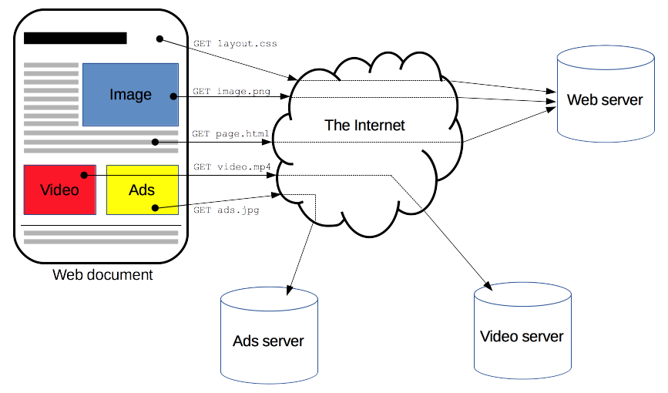
COMMUNICATION OF WEB BROWSER WITH SERVER
Notes:
При роботі з веб-додатком завжди є 2 учасника – 1ий сервер (ПК із спеціальним ПЗ, яке оброблює запити до сервера і відправляє назад HTML-файл, картинку і т.д.), 2-ий клієнт. Клієнт, фактично здійснює запит із браузера (відправляє дані від юзера на сервер), отримує відповідь від сервера і візуалізує цю відповідь.

Slide 5
HTTP
Hypertext Transfer Protocol (HTTP) is an application protocol for the transmission of hypertext documents such as HTML.
It is designed to communicate between web browsers and web servers, although in principle HTTP can be used for other purposes.
The protocol follows the classic client-server model when the client opens a connection to create a request and then waits for a response.
HTTP is a stateless protocol, that is, the server does not store any data (status) between two request-response pairs.
Although HTTP is TCP/IP based, it can also use any other transport layer with guaranteed delivery.

Slide 6
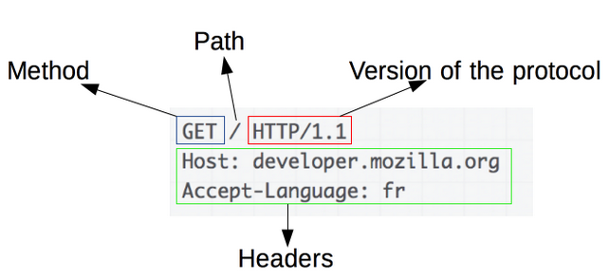
HTTP request structure
Notes:
- Коли юзер в адресному рядку вводить ім’я сайту на який хоче зайти, браузер відправляє текстове повідомлення на сервер в певному форматі (це запит, request).
1) HTTP-метод, зазвичай дієслово подібно GET, POST або іменник, як OPTIONS або HEAD, що визначає операцію, яку клієнт хоче виконати. Зазвичай, клієнт хоче отримати ресурс (використовуючи GET) або передати значення HTML-форми (використовуючи POST).
2) Шлях до ресурсу: URL ресурси позбавлені елементів, які очевидні з контексту, наприклад без protocol (http: //), domain (тут developer.mozilla.org), або TCP port (тут 80).
3) Версія HTTP-протоколу в версії HTTP/1.1 читаються людиною, в HTTP/2 ні.
4) Заголовки (опціонально), надають додаткову інформацію для сервера.
5) Або тіло, для деяких методів, таких як POST, яке містить відправлений ресурс.

Slide 7
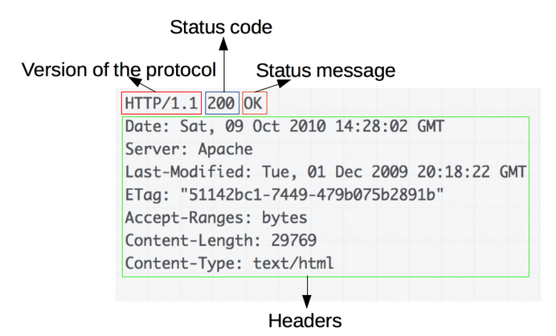
HTTP response structure

Slide 8
HTTP request methods
GET - the GET method requests the representation of a resource. Queries using this method can only receive data.
POST - used to send data to a specific resource. It often causes a change in status or some side effects on the server.
PUT - replaces all current views of the resource with query data.
PATCH - used to partially modify a resource.
DELETE - deletes the specified resource.
OPTIONS - is used to describe the connection options of a resource.
Notes:
POST - використовується для відправки даних до певного ресурсу. Часто викликає зміну стану або якісь побічні ефекти на сервері
PUT - замінює всі поточні представлення ресурсу даними запиту
PATCH - використовується для часткової зміни ресурсу

Slide 9
HTTP status codes
1xx Informational responses - request received, process continues
2xx Success - the request was successfully received, understood and processed
3xx Redirection - further steps are required to complete the request
4xx Client errors - the query contains bad syntax or cannot be executed
5xx Server errors - the server did not complete the request
Full list HTTP Status Messages

Slide 10
IDEMPOTENCE METHODS
The HTTP method is idempotent if the repeated identical request, made one or more times in a row, has the same effect, which does not change the status of the server.
In other words, the idempotent method should have no side-effects other than collecting statistics or similar operations.
The GET, HEAD, PUT and DELETE methods are idempotent, but not the POST method. Also, all safe methods are idempotent.
The GET, HEAD, OPTIONS, and TRACE methods are defined as secure, meaning that they are for information only and should not change the status of the server.

Slide 11
STATELESS PROTOCOL
The stateless protocol is a data protocol that assigns each request to an independent transaction that is not associated with a previous request, that is, communicating with the server consists of independent request-response pairs.
The stateless protocol does not require storing session information on the server or status for each client during multiple requests. In contrast, a protocol that requires an account of the server's internal state is called a stateful protocol.
Sample protocol without saving status - HTTP means that every request message can be understood in isolation from other requests.

Slide 12
AJAX

Slide 13
AJAX
AJAX (Asynchronous JavaScript and XML) - server access technology without reloading the page. This reduces response time and makes the web application more like a desktop.
AJAX allows web pages to be updated asynchronously by exchanging data with a web server behind the scenes. This means that it is possible to update parts of a web page, without reloading the whole page.
AJAX is a web development technique for creating interactive and fast web applications.

Slide 14
AJAX. A COMBINATION OF TECHNOLOGIES
JavaScript
- Loosely typed scripting language.
- JavaScript function is called when an event occurs in a page.
- Glue for the whole AJAX operation.
DOM
- API for accessing and manipulating structured documents.
- Represents the structure of XML and HTML documents.
CSS
- Allows for a clear separation of the presentation style from the content and may be changed programmatically by JavaScript
XMLHttpRequest
- JavaScript object that performs asynchronous interaction with the server.

Slide 15
CLASSIC WEB APPLICATION MODEL
Web-browser
User interface
HTTP
request
HTTP response
(HTML + CSS)
Web-server
Notes:
Є сервер, браузер, користувацький інтерфейс. Юзер натискає на кнопку і ініціює запит на сервер і отримує від нього відповідь (HTML-сторінку). Потім юзер знову натискає на кнопку, йде новий запит на сервер, отримується нова сторінка, а стара викидається! Постійне повне оновлення документа.

Slide 16
AJAX WEB APPLICATION MODEL
Web-browser
User interface
XMLHttpRequest
HTTP
request
HTTP response
(HTML + CSS)
Web-server
Notes:
Для додатку з AJAX перший раз скачується вся сторінка, а при подальших зверненнях на сервер, коли ми натискаємо якусь кнопку – ми робимо запит не із браузера, а із JavaScript коду. Використовуємо спеціальний об’єкт XMLHttpRequest – він робить запит до сервера, отримує від сервера відповідь (це може бути ціла сторінка, чи якийсь текст) і оновлює відповідну частину документа. Таким чином для користувача не відбувається оновлення всієї сторінки (немає жодного статусу завантаження сторінки).

Slide 17
DATA FORMATS FOR EXCHANGE WITH SERVER
Data formats for exchange with server
XML
XML (eXtensible Markup Language) - extensible markup language. XML solves the problem of storing and transporting data, focusing on what that data is, HTML solves the problem of displaying data, focusing on how that data looks.
HTML
Simple HTML code. This data is often called HTML snippets (code snippets).
JSON
JSON (JavaScript Object Notation). The general idea is to deliver some text (string) that can be interpreted as a JavaScript object

Slide 18
STEP 1. CREATE AN XMLHTTPREQUEST OBJECT
Before you perform Ajax communication between client and server, the first thing you must do is to instantiate an XMLHttpRequest object, as shown below:
1) const ajaxRequest = new XMLHttpRequest();
The XMLHttpRequest object allows JavaScript to make HTTP requests to the server without reloading the page from JavaScript.
Despite the word "XML" in the title, XMLHttpRequest can work with any data, and not just with XML.
All modern browsers (Chrome, Firefox, IE7+, Edge, Safari, Opera) have a built-in XMLHttpRequest object.

Slide 19
STEP 2. CONFIGURING THE XMLHTTPREQUEST OBJECT
Next step in sending the request to the server is to instantiating the newly-created request object using the open() method of the XMLHttpRequest object:
2) ajaxRequest.open(method, URL, [async, user, password] );
- method: HTTP-method. As a rule, GET or POST is used, although more exotic ones are available, like TRACE / DELETE / PUT, etc.
- URL: request address - the server (file) location. You can use not only http/https, but other protocols, such as ftp:// and file://. - async: true (asynchronous) or false (synchronous)
- user, password - login and password for HTTP authorization, if needed.
Example:
ajaxRequest.open("GET", "info.txt", true);

Slide 20
STEP 3. HANDLING SERVER RESPONSE
The readyState property holds the status of the XMLHttpRequest.
The onreadystatechange property defines a function to be executed when the readyState changes.
The status property and the statusText property holds the status of the XMLHttpRequest object.
3)
ajaxRequest.onreadystatechange = function () {
if (ajaxRequest.readyState < 4)
// while waiting response from server
document.getElementById('div1').innerHTML = "Loading...";
} else if (ajaxRequest.readyState === 4) {
// 4 = Response from server has been completely loaded.
if (ajaxRequest.status == 200) {
// http status is 200 - successful
document.getElementById('div1').innerHTML = ajaxRequest.responseText;
}
}

Slide 21
READYSTATE PROPERTIES
0 – UNSENT – initial state.
1 – OPENED – called open
2 - HEADERS_RECEIVED – received headers
3 – LOADING – body being loaded (regular data packet received)
4 – DONE – request completed
The request passes the states in the order 0 → 1 → 2 → 3 →… → 3 → 4, state 3 is repeated every time the next data packet is received over the network.

Slide 22
EVENTS DURING REQUEST PROCESSING
Loadstart – request started
Progress – the browser received another data packet
Abort – request canceled
Error – an error occurred
Load – the request was successfully (no error) completed
Timeout – request completed by timeout
Loadend - request completed (successful or unsuccessful)

Slide 23
XMLHTTPREQUEST METHODS
Method | Description
new XMLHttpRequest() | Creates a new XMLHttpRequest object
abort() | Cancels the current request
getAllResponseHeaders() | Returns header information
getResponseHeader() | Returns specific header information
open(method, url, async, user, psw) | Specifies the type of request
send() | Sends the request to the server. Used for GET requests
send(string) | Sends the request to the server. Used for POST requests
setRequestHeader() | Adds a label/value pair to the header to be sent

Slide 24
XMLHTTPREQUEST PROPERTIES
Property | Description
onreadystatechange | Defines a function to be called when the readyState property changes
readyState | Holds the status of the XMLHttpRequest (possible values 0, 1, 2, 3, 4)
responseText | Returns the response data as a string
responseXML | Returns the response data as XML data
status | Returns the status-number of a request (from 1xx to 5xx)
statusText | Returns the status-text (e.g. "OK" or "Not Found")

Slide 25
STEP 4. SENDING A REQUEST TO THE SERVER
To send a request to a server, we use the send() method of the XMLHttpRequest object:
4) ajaxRequest.send( [body] );
This method opens the connection and sends a request to the server.
The body is the request body. Not every request has a body, for example, GET-requests do not have a body, while POST has basic data just transmitted through the body.
Post request with body example:
ajaxRequest.open("POST", "demo_post2.asp", true);
ajaxRequest.setRequestHeader("Content-type", "application/x-www-form-urlencoded");
ajaxRequest.send("fname=Henry&lname=Ford");
Notes:
setRequestHeader() - задає параметри заголовків запиту, що передаються на сервер. Для POST-запитів він обов’язковий.

Slide 26
GET VS POST
GET requests can be cached
GET requests remain in the browser history
GET requests can be bookmarked
GET requests should never be used when dealing with sensitive data
GET requests have length restrictions
GET requests should be used only to retrieve data
POST requests are never cached
POST requests do not remain in the browser history
POST requests cannot be bookmarked
POST requests have no restrictions on data length
vs

Slide 27
SYNCHRONOUS AND ASYNCHRONOUS REQUESTS
If the open method sets the async parameter to false, the request will be synchronous.
Synchronous calls are used extremely rarely, as they block the interaction with the page until the download is completed.
// Synchronous request
ajaxRequest.open('GET', ‘data.json', false);
// Send him
ajaxRequest.send();
// ... all JavaScript will "hang" until the request is completed
To make the request asynchronous, we set the async parameter to true.
!
Synchronous XMLHttpRequest (async = false) is not recommended because the JavaScript will stop executing until the server response is ready.

Slide 28
AN EXAMPLE OF USING XMLHTTPREQUEST
// 1. Create a new object XMLHttpRequest
let ajaxRequest = new XMLHttpRequest();
// 2. Configuring it: GET request to URL 'data.json'
ajaxRequest.open('GET', ‘data.json', true); // asynchronous requests
// 3. If the server response code is not 200, then this is an error
if (ajaxRequest.status != 200) {
// handle error
alert(ajaxRequest.status + ': ' + ajaxRequest.statusText); // sample output: 404: Not Found
} else {
// display the result
alert(ajaxRequest.responseText); // responseText -- response text
}
// 4. Sending request
ajaxRequest.send();

Slide 29
FULL EXAMPLE: AJAX WITH HTML & JAVASCRIPT
<!DOCTYPE HTML>
<html>
<head>
<meta charset="utf-8">
</head>
<body>
<button onclick="downloadBooks()">Download books</button>
<script>
function downloadBooks() {
const ajaxRequest = new XMLHttpRequest();
ajaxRequest.open('GET', 'books.json', true);
ajaxRequest.onreadystatechange = function() { // for asynchronous requests
if (ajaxRequest.readyState != 4) return; // for asynchronous requests
if (ajaxRequest.status != 200) {
alert(‘Error ' + ajaxRequest.status + ': ' + ajaxRequest.statusText);
} else { alert(ajaxRequest.responseText); }
}
ajaxRequest.send();
}
</script>
</body>
</html>

Slide 30
SERVER ON NODEJS. SETTING UP THE ENVIRONMENT
1. First install the Node.JS server itself (http://nodejs.org)
2. Select the directory where you will solve problems. Run in it:
npm install node-static
This will install the node-static module in the current directory, which will become automatically available for scripts from subdirectories.
Node-static simple flexible module for reading and writing files for Node. Node-static understands and supports conditional GET and HEAD requests.
!
If you have Windows and the command did not work, then most likely the fact is that new paths “jumped”. Restart the file manager or console.

Slide 31
SERVER ON NODEJS. VERIFICATION
const http = require('http');
var url = require('url');
var static = require('node-static');
var file = new static.Server('.');
function accept(req, res) {
if (req.url == '/files_on_server.json') {
file.serve(req, res); // can set delay
} else {
file.serve(req, res);
}
}
// ------ run server ------- http.createServer(accept).listen(8080);
console.log("Server running on port 8080");

Slide 32
SAME ORIGIN POLICY & AJAX
The same-origin policy is a critical security mechanism that restricts how a document or script loaded from one origin can interact with a resource from another origin.
For security reasons, browsers do not allow you to make cross-domain AJAX requests. This means you can only make AJAX requests to URLs from the same domain as the original page, for example, if your application is running on the domain "mysite.com", you cannot make AJAX request to "othersite.com" or any other domain.
To overcome this restriction it is possible to use JSONP and CORS.

Slide 33
Useful links
https://developer.mozilla.org/en-US/docs/Web/HTTP/Overview
https://www.tutorialspoint.com/ajax/index.htm
http://learn.javascript.ru/ajax
https://www.w3schools.com/js/js_ajax_intro.asp

Slide 34
THANKS

